Slide 1
United Nations Development Agenda: 2000 Millennium Development Goals to Post-2015 Sustainable Development Goals
“Uniting for a Sustainable Future”
Southern California Division, United Nations Association-USA
November 1, 2014
Chapman College, Orange CA
Notes:
Thanks for being here. I am CLM OC chapter pres. You are here because you are either a leader of today or a future leader of tomorrow.
SoCal Division covers a population of roughly 25 million people, more than half the pop of CA & roughly 8% of the US pop. More than one in every 100 people in the US live in OC alone. So what we do here today is important.
The purpose of our event is to gather input on the inclusion of specific goals and targets to be shared with the U.S. SDG negotiators. How we will do this will be covered by your mediators/facilators in your individual breakout sessions in further detail.
Most importantly, today’s event is the beginning of a process to ensure the success of the SDGs. This event will report back with recommendations for continuing to build support for the SDGs through advocacy, outreach and public awareness. These recommendations will be part of a final UNA-USA Action Plan for supporting the implementation of the SDGs in 2015.
Much of the material in my brief presentation will be covered too rapidly for you to take good notes and the volume of paper needed to give each attendee a full copy of it would be beyond our budget. So the details of this presentation will be posted on the SoCal Division web site so any group that wishes in the future to report on the SGDs will have the visuals from this presentation as a reference.

Slide 2
Why We Are Here Today
Gather input to be shared with the U.S. Department of State and U.S. UN Mission during the final stage of negotiations
Educate our community on the Post-2015 Development Agenda and Sustainable Development Goals
Lay the groundwork for taking action to advocate the U.S. Congress and local governments to be leaders in implementing the SDGs at home and abroad
Notes:
Member States must agree on the final goals and targets. Once these are in place, countries must make the necessary changes to implement strategies for addressing goals. The role of U.S. leadership is critical, for without a strong commitment from the United States to allocate resources and form policy to address targets, little progress can be made on critical issues such as poverty, education and climate change. The goal is for the SDGs to be “global in nature and universally applicable” but account for different national cultural practices, capabilities and levels of development and respect national policies and priorities. A “universally applicable” agenda means that every country, including the U.S. will be expected to show progress towards nationally defined targets that will contribute to the overall SDGs.

Slide 3
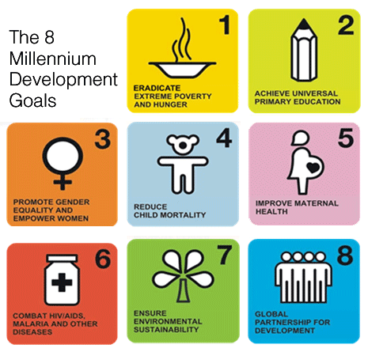
History of the MDGs
In 2000, the Millennium Declaration was adopted but did not contain the MDGs in their present form. In 2001, a team of UN experts created the MDGs with indicators, without any inter-governmental process.
Notes:
Note that the MDGs were not promulgated until 2001 and were created by a team of UN “experts.”

Slide 4
MDGs
Eradicate extreme poverty and hunger
Achieve universal primary education
3. Promote gender equality and empower women
4. Reduce child mortality
5. Improve maternal health
6. Combat HIV/AIDS, malaria and other diseases
7. Ensure environmental sustainability
8. Develop a global partnership for development
Notes:
On this slide you see the goals listed in full. In the succeeding eight slides, which time does not permit me to cover in any detail, you will see how successfully the world community met the goals set forth in 2000. Again, the slides will be posted on our Division Web Site

Slide 5
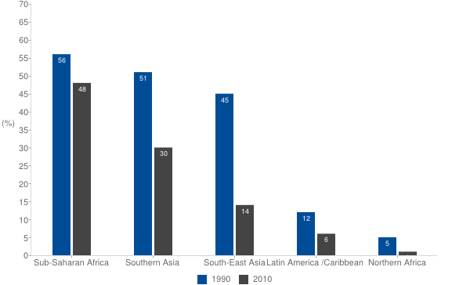
Goal 1 – Eradicate extreme poverty and hunger
1.2 billion still live in extreme poverty, even though poverty rates have been halved between 1990 and 2010 and the MDG target has been met.
Percent of people living on less than $1.25 a day
Notes:
Reduce by half the proportion of people living on less than a dollar a day.
Reduce by half the proportion of people who suffer from hunger.

Slide 6
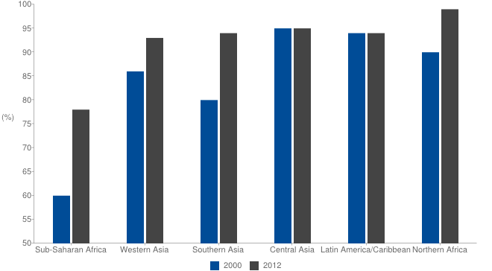
Goal 2 – Achieve universal primary school education
Despite impressive strides forward at the start of the decade, progress in reducing the number of children out of school has slackened considerably.
Net enrollment rates
Notes:
Ensure that all boys and girls complete a full course of primary schooling.

Slide 7
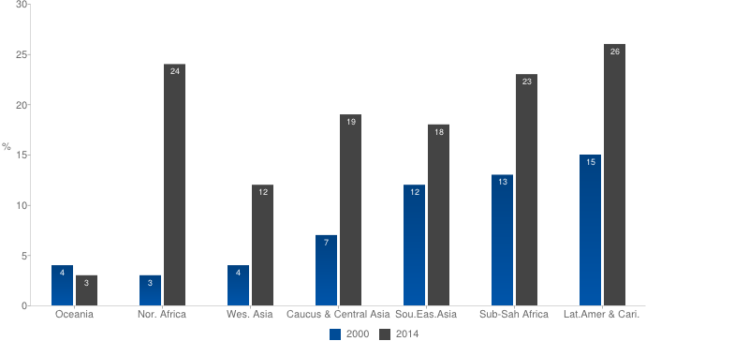
Goal 3 – Promote gender equality and empower women
Women are assuming more power in the world’s parliaments, boosted by quota systems.
Percent of women in national parliaments
Notes:
Eliminate gender disparity in primary and secondary education preferably by 2005, and at all levels by 2015.

Slide 8
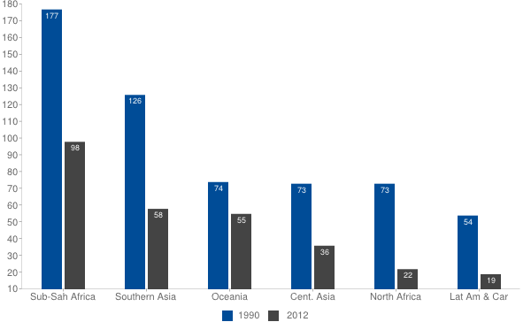
Goal 4 – Reduce child mortality
Despite substantial progress, the world is still falling short of the MDG child mortality target.
Child mortality rates have been halved.
Notes:
Reduce by two thirds the mortality rate among children under five

Slide 9
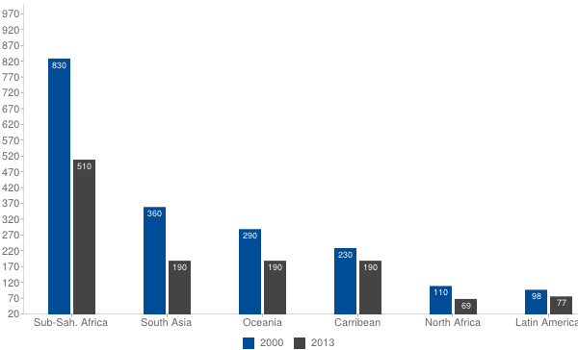
Goal 5 – Improve maternal health
Much more still needs to be done to reduce maternal mortality.
Maternal mortality ratio.
Notes:
Improve maternal health
Reduce by three quarters the maternal mortality ratio.

Slide 10
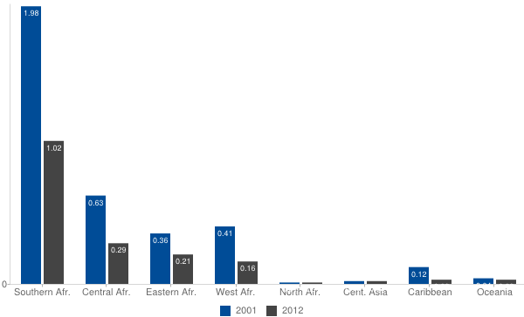
Goal 6 – Combat HIV/AIDS, malaria & other diseases
There are still too many new cases of HIV infection.
HIV incidence rate
Notes:
Combat HIV/AIDS, malaria and other diseases
Halt and begin to reverse the spread of HIV/AIDS.
Halt and begin to reverse the incidence of malaria and other major diseases.

Slide 11
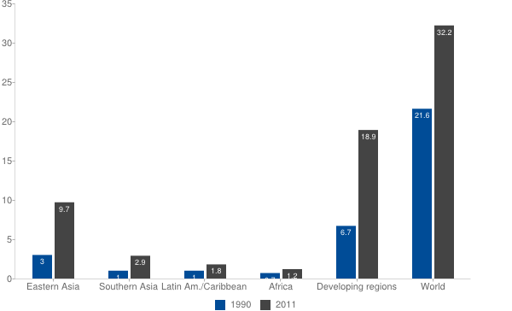
Goal 7 – Ensure environmental sustainability
Millions of hectares of forest are lost every year, threatening this valuable asset. Global greenhouse gas emissions continue their upward trend.
Emissions of CO2 up 50%
Notes:
Integrate the principles of sustainable development into country policies and programs; reverse loss of environmental resources.
Reduce by half the proportion of people without sustainable access to safe drinking water.
Achieve significant improvement in lives of at least 100 million slum dwellers, by 2020.

Slide 12
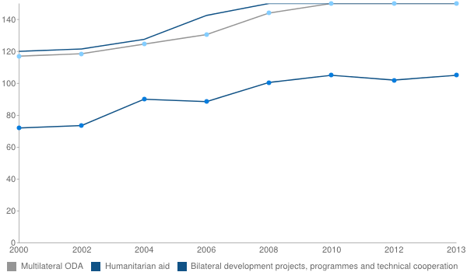
Goal 8 – A global partnership for development
Official development assistance is now at its highest level, reversing the decline of the previous two years.
Official development assistance
Notes:
Develop further an open trading and financial system that is rule-based, predictable and non-discriminatory. Includes a commitment to good governance, development and poverty reduction—nationally and internationally.
Address the least developed countries’ special needs. This includes tariff- and quota-free access for their exports; enhanced debt relief for heavily indebted poor countries; cancellation of official bilateral debt; and more generous official development assistance for countries committed to poverty reduction.
Address the special needs of landlocked and small island developing States.
Deal comprehensively with developing countries’ debt problems through national and international measures to make debt sustainable in the long term.
In cooperation with the developing countries, develop decent and productive work for youth.
In cooperation with pharmaceutical companies, provide access to affordable essential drugs in developing countries.
In cooperation with the private sector, make available the benefits of new technologies—especially information and communications technologies.

Slide 13
Post-2015 Agenda – The World We Want
In 88 countries, groups of stakeholders, with the support of the UN, held conferences, workshops and face-to-face meetings on what should be included in the future global development agenda.
Thousands of people, including leading practitioners, are participating online and in person in global thematic consultations on how to integrate the following eleven issues into the Post-2015 agenda: inequalities, health, education, growth and employment, environmental sustainability, governance, conflict and fragility, population dynamics, hunger, food and nutrition security, energy, water. All consultations can be followed on the World We Want website.
A MY World survey, available in 10 languages, invited people to vote for six out of 16 priorities for the future development agenda.
Notes:
A My World ballot is in your folder. Be sure to vote before the end of he event and leave your ballot to be counted.

Slide 14
Principles - Sustainable development goals
Be based on Agenda 21 and the Johannesburg Plan of Implementation.
Fully respect all the Rio Principles.
Be consistent with international law.
Build upon commitments already made.
Contribute to the full implementation of the outcomes of all major summits in the economic, social and environmental fields.
Focus on priority areas for the achievement of sustainable development, being guided by the outcome document.
Address and incorporate in a balanced way all three dimensions of sustainable development and their interlinkages.
Be coherent with and integrated into the United Nations development agenda beyond 2015.
Not divert focus or effort from the achievement of the Millennium Development Goals.
Include active involvement of all relevant stakeholders in the process.
Notes:
Stress points 1., 5., 6. and 10.

Slide 15
Open Working Group Document – Emerging SDGs
1. End poverty in all its forms everywhere
2. End hunger, achieve food security and improved nutrition, and promote sustainable agriculture
3. Ensure healthy lives and promote well-being for all at all ages
4. Ensure inclusive and equitable quality education and promote life-long learning opportunities for all
5. Achieve gender equality and empower all women and girls
6. Ensure availability and sustainable management of water and sanitation for all
7. Ensure access to affordable, reliable, sustainable, and modern energy for all
8. Promote sustained, inclusive and sustainable economic growth, full and productive employment and decent work for all
9. Build resilient infrastructure, promote inclusive and sustainable industrialization and foster innovation
Notes:
Sustainable appears 5 times

Slide 16
Open Working Group Document – Emerging SDGs
10. Reduce inequality within and among countries
11. Make cities and human settlements inclusive, safe, resilient and sustainable
12. Ensure sustainable consumption and production patterns
13. Take urgent action to combat climate change and its impacts*
14. Conserve and sustainably use the oceans, seas and marine resources for sustainable development
15. Protect, restore and promote sustainable use of terrestrial ecosystems, sustainably manage forests, combat desertification, and halt and reverse land degradation and halt biodiversity loss
16. Promote peaceful and inclusive societies for sustainable development, provide access to justice for all and build effective, accountable and inclusive institutions at all levels
17. Strengthen the means of implementation and revitalize the global partnership for sustainable development
Notes:
Sustainable appears 6 times

Slide 17
Four Topics for Today
Ensure inclusive and equitable quality education and promote life long learning opportunities for all
Achieve gender equality and empower all women and girls
Take urgent action to combat climate change and its impact
Promote peaceful and inclusive societies for sustainable development, provide access to justice for all and build effective, accountable and inclusive institutions at all levels
Notes:
See OWG goals 4 and 5
See OWG goal 5
See OWG goal 13
See OWG goals 9, 11, 12, 16 and 17

Slide 18
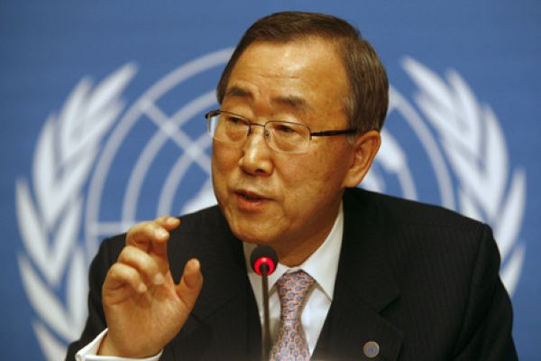
UN Secretary General Ban Ki-moon
“Member States are now fully engaged in discussions to define Sustainable Development Goals (SDGs), which will serve as the core of a universal post-2015 development agenda.
Our efforts to achieve the MDGs are a critical building block towards establishing a stable foundation for our development efforts beyond 2015.”

Slide 19
“One's philosophy is not best expressed in words; it is expressed in the choices one makes... and the choices we make are ultimately our responsibility.”
Eleanor Roosevelt,
Long time spokesperson for UNA-USA
Notes:
ER is also responsible for the Universal Declaration of Human Rights adopted in 1948 by the UN among other accomplishments

